Slide 1

Crop Yield Prediction Using Machine Learning
TEAM NUMBER: 02
CSE - B
Under Supervision of
Dr. G. Chamundeswari Professor & Head
Department of CSE
Ramachandra College of Engineering (Autonomous)
Approved by AICTE, Permanently Affiliated to JNTUK, Recognized by UGC 2(f) & 12(B), Accredited by NAAC A+, Accredited by NBA, ISO 9001:2015 Certified
NH-16, Bypass Road, Vatluru (V), Eluru – 534007, Eluru Dt., A.P.
2023-24

Slide 2
Abstract :
Crop yield prediction is an essential predictive analytics technique in the agriculture industry. It is an agricultural practice that can help farmers and farming businesses predict crop yield in a particular season when to plant a crop, and when to harvest for better crop yield.
Predictive analytics is a powerful tool that can help to improve decision-making in the agriculture industry. It can be used for crop yield prediction, risk mitigation, reducing the cost of fertilizers, etc. The crop yield prediction using ML and flask deployment will find analysis on weather conditions, soil quality, fruit set, fruit mass, etc.
The impact of climate change in India, most of the agriculture crop are badly affected in term of their performance over a period of last decades. Predicting the crop yield in advance of its harvest would help the policy makers and farmers for taking appropriate measure for marketing and storage.
The result of the prediction will made available to the farmer. Thus for such kind of data analytics in crop prediction, there are different techniques or algorithm is used, and with the help of those algorithms we can predict the crop yield. The main concept is to increase the throughput of the agriculture sector with the machine learning models.

Slide 3
Overview:
Our project represents a groundbreaking initiative focused on revolutionizing agricultural management practices, by harnessing the power of predictive analytics and machine learning techniques. We aim to enhance the efficiency and productivity of farming operations. Through the integration of advanced data analysis methods, we seek to provide farmers and agricultural stakeholders with valuable insights for optimizing crop yield prediction and resource allocation strategies.
The core point of our project was to develop robust predictive models capable of accurately forecasting crop yields. By using historical and real-time data on environmental conditions, soil characteristics, and crop phenology. We strive to uncover hidden patterns and relationships that influence crop growth and development. Through collaboration with experts in the field and the utilization of cutting-edge technologies, we aspire to empower stakeholders with actionable insights to make informed decisions and drive sustainable agricultural practices forward.
The Crop Yield Prediction uses the various farm inputs, weather conditions, type of soil is used to predict the suitable crop in the particular scenario and the predicted crop yield in terms of kilograms per hectare. The Farm inputs include the seeds, fertilisers, pesticides, machinery, and labour. In our project we are considering only the fertility of the soil that is the ability of soil to sustain plant growth and optimize crop yield.

Slide 4
Objective :
To Improve Agricultural Planning
Optimize Resource Allocation
Improve Agricultural Productivity and Sustainability
Analysing Market and Forecast Assist

Slide 5
Project Goals:
Support Food Security: Contribute to food security and resilience by ensuring stable and predictable crop production, reducing vulnerabilities to weather-related disruptions, and enhancing the reliability of food supply chains.
Enable Research and Innovation: Support research efforts in agronomy, climate science, and data analytics to develop advanced models, tools, and technologies for crop yield prediction, precision agriculture, and climate-smart farming practices. Proper
Agricultural Planning: Provide farmers with proper forecasts of crop yields based on weather conditions to assist in planning planting schedules, resource allocation, and crop management practices.
Visualization and Interpretation: Visualizing historical weather patterns, crop yields, and model predictions using charts, graphs, and maps.

Slide 6
Beneficiaries
Enhanced Predictive Accuracy.
Automated Data Processing.
Scalability.
Real-time Insights.

Slide 7
Existing System:
There are many machine learning models related to the crops. The Existed system contains the inputs like the type of soil, weather conditions like temperature, humidity, rainfall. The output will be only the recommended crop.
The other models related to the crop yield for the particular crop that takes the inputs are the type of soil, weather conditions like temperature, humidity, rainfall and type of crop and produce the crop yield at the end of the season in terms of the kilograms per hectare.
The existed model hasn’t perform effectively for the farmers because the model only predicts the output of the crop but can’t recommend the suitable crop for those conditions.

Slide 8
Proposed System:
The Proposed System came against the disadvantage of the existed system. The proposed system contains the inputs like the type of soil, weather conditions (temperature, humidity, rainfall) and also most important factors in the soil are N, P and K Values (N – Nitrogen , P – Phosphrous, K – Potassium)
The N, P and K Values (N – Nitrogen , P – Phosphrous, K – Potassium) plays a key role in our proposed system, our model will utilize the values and recommend the crop with the help of decision tree algorithm and random forest .
Our algorithm will be trained on this data to learn the relationships between the inputs and outputs.The output of our model will be recommending crop and the crop yield in the terms of the kilograms per hectare.

Slide 9
Differences Between Existing and Proposed Systems
Existing System Con’s
Limited Predictive Accuracy
Manual Data Processing
Limited Scalability
Lack of Real-time Insights
Can’t provide the yield quantity based on N, P, K values
Proposed System Pro’s
Enhanced Predictive Accuracy
Automated Data Processing
Doesn’t Limit Scalability
Mostly Real-time Insights
Our Model Can provide the yield quantity based on N, P, K values as well as weather conditions

Slide 10
Literature Survey :
“Machine learning approach for forecasting crop yield based on climatic parameters”
Author: S.Veenadhari, Dr. Bharat Misra, Dr. CD Singh
Climate plays an important role in the field of agriculture. Over this year due to increase in global warming climate has been affected badly and it had a great impact on crops. Predicting the crop yield will tell the farmers what to harvest depending upon the predictive analysis.
“Crop Selection Method to Maximize Crop Yield Rate using Machine Learning Technique”
Author: Rakesh Kumar1, M.P. Singh2, Prabhat Kumar 3 and J.P. Singh
Food Security and Economic Growth are one of the important factors in the field of Agriculture across the agro-based countries. Crop Selection is a difficult task for agriculture planning depending on the climate. It depends on various aspects such as climatic conditions, Market price, production rate and Government policy.

Slide 11
Software Requirements:
Machine Learning Framework: TensorFlow, Keras, and scikit-learn
Preferred Programming Language: Python
Libraries: NumPy, Pandas, and Matplotlib are used for data manipulation, data analysis, and data visualization.
Development Environment: Integrated Development Environments (IDEs) like Google Colab and PyCharm are used for machine learning development.
Operating system: Windows 10 or above.

Slide 12
Hardware Requirements:
Processor: A modern multicore processor, such as an Intel Core i5 or i7, is recommended for training and deploying machine learning models.
RAM: 8GB or higher for efficient model training and development.
Storage: Solid State Drive (SSD) for faster read/write operations during data preprocessing and model training.

Slide 13
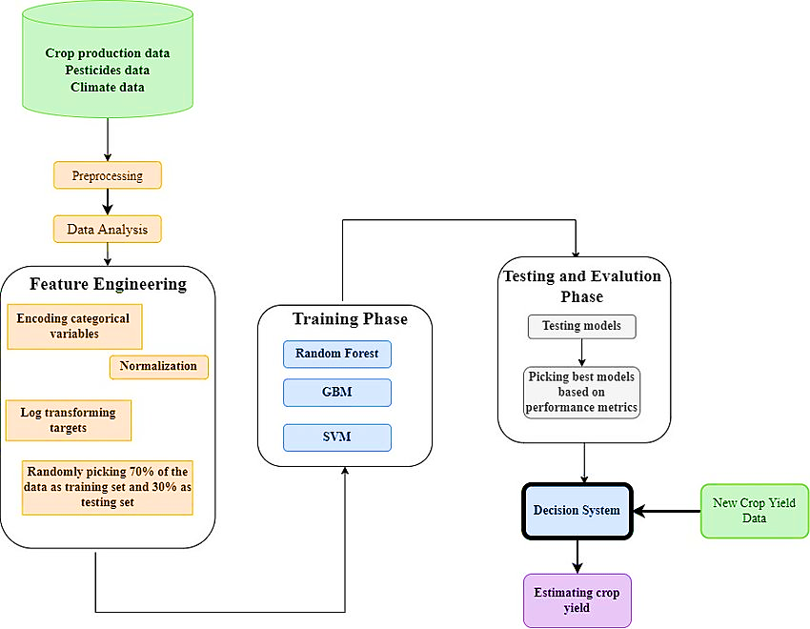
Methodology

Slide 14
System Architecture
System architecture is represented in below diagram. The machine learning model starts from the dataset containing the required features, later the Preprocessing data contains techniques like handling missing data, data cleaning.
The exploring data is a crucial step in the machine learning pipeline that involves correlation analysis and visualizing the dataset to gain insights, understand the underlying patterns, and inform subsequent modelling decisions.
The train-test split is a fundamental step used to evaluate the performance of a model. It involves dividing the dataset into two subsets: one for training the model and the other for testing its performance. This split allows us to assess how well the trained model generalizes to unseen data. we can perform a train-test split using the scikit-learn library in python.
The train and evaluating process allows you to train and evaluate machine learning algorithms on your dataset, helping you understand how well the model performs on unseen data and guiding you in the selection of the best-performing algorithm for your task. Using Flask with machine learning allows you to create web applications that serve machine learning models.

Slide 15
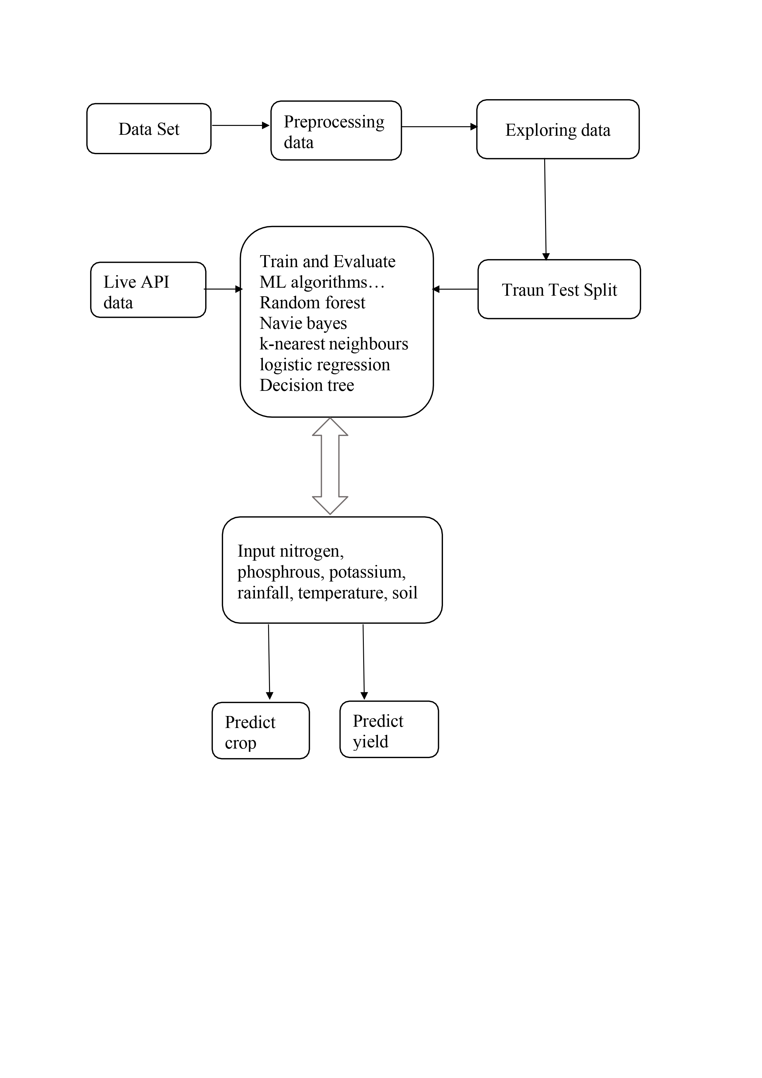

Slide 16
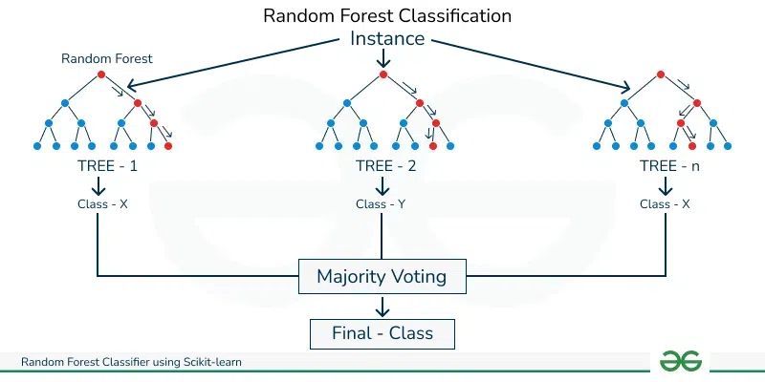
Random Forest Classifier:
Algorithms and Models:
A Random Forest Classifier is used to predict the type of crop to be cultivated based on the given environmental features. This is indicated by the prediction of the crop_num variable, which represents the type of crop (e.g., rice or maize). The classifier is trained to classify the crops into different categories based on the features provided
The Random Forest classifier creates a set of decision trees from a randomly selected subset of the training set. It is a set of decision trees (DT) from a randomly selected subset of the training set and then it collects the votes from different decision trees to decide the final prediction.

Slide 17
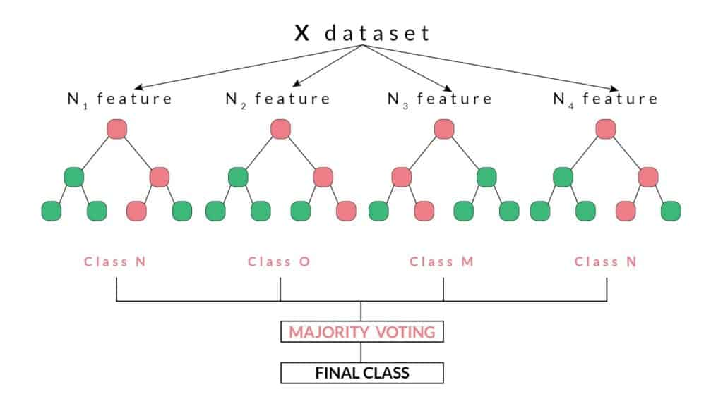
Random Forest Regression
Random Forest Regression in machine learning is an ensemble technique capable of performing both regression and classification tasks with the use of multiple decision trees and a technique called Bootstrap and Aggregation, commonly known as bagging. The basic idea behind this is to combine multiple decision trees in determining the final output rather than relying on individual decision trees.After determining the type of crop using the classifier, a Random Forest Regressor is used to predict the yield of the identified crop. The regressor takes the same set of environmental features but predicts a continuous variable: the yield of the specific crop identified in the classification step. The regressor is trained to estimate the yield output based on the environmental conditions for a particular crop. Here's an expanded explanation of Random Forest Regression in the context of crop yield prediction:

Slide 18
Coding :- Google Colab
import numpy as np
import pandas as pd
crop = pd.read_csv("cs-1.csv")
crop.head()
#Display the first few rows using the head() function
crop.dtypes
crop.shape
#Number of rows and columns
crop.info()
#info()-information about the data types, non-null counts, and memory usage.
crop.isnull().sum()
crop.duplicated().sum()
#This will display the number of duplicate rows in the DataFrame crop
crop.describe()
#describe() method in pandas generates descriptive statistics of the numerical columns in a DataFrame.
corr=crop.corr()
corr
#returns a correlation matrix.
crop_dict = {
'rice': 1,
'maize': 2
}
crop['crop_num']=crop['label'].map(crop_dict) #crop['crop_num']-It will create a new column called crop num.
#map()-function is used to apply this mapping to each value in the 'label' column.
crop['crop_num'].value_counts()
X = crop.drop(['crop_num','label','yield'],axis=1)
y = crop[['crop_num','yield']]
#features-X
#target variable -y
from sklearn.model_selection import train_test_split
from sklearn.preprocessing import OneHotEncoder
from sklearn.compose import ColumnTransformer
from sklearn.preprocessing import StandardScaler
ohe = OneHotEncoder(drop='first')
scale = StandardScaler()
preprocesser = ColumnTransformer(
transformers = [
('StandardScale', scale, [0, 1, 2, 3,4,5,6]),
('OHE', ohe, [7]),
],
remainder='passthrough'
)
X_train, X_test, y_train, y_test = train_test_split(X, y, test_size=0.2, random_state=42)
X_train_dummy = preprocesser.fit_transform(X_train)
X_test_dummy = preprocesser.transform(X_test)
from sklearn.preprocessing import MinMaxScaler
ms = MinMaxScaler()
X_train_dummy = ms.fit_transform(X_train_dummy)
X_test_dummy = ms.transform(X_test_dummy)
from sklearn.preprocessing import StandardScaler
sc = StandardScaler()
sc.fit(X_train_dummy)
X_train_dummy = sc.transform(X_train_dummy)
X_test_dummy = sc.transform(X_test_dummy)
from sklearn.linear_model import LogisticRegression
from sklearn.naive_bayes import GaussianNB
from sklearn.svm import SVC
from sklearn.neighbors import KNeighborsClassifier
from sklearn.tree import DecisionTreeClassifier
from sklearn.tree import ExtraTreeClassifier
from sklearn.ensemble import RandomForestClassifier
from sklearn.ensemble import BaggingClassifier
from sklearn.ensemble import GradientBoostingClassifier
from sklearn.ensemble import AdaBoostClassifier
from sklearn.metrics import accuracy_score
# create instances of all models
models = {
'Logistic Regression': LogisticRegression(),
'Naive Bayes': GaussianNB(),
'Support Vector Machine': SVC(),
'K-Nearest Neighbors': KNeighborsClassifier(),
'Decision Tree': DecisionTreeClassifier(),
'Random Forest': RandomForestClassifier(),
'Bagging': BaggingClassifier(),
'AdaBoost': AdaBoostClassifier(),
'Gradient Boosting': GradientBoostingClassifier(),
'Extra Trees': ExtraTreeClassifier(),
}
y_train_crop_num = y_train['crop_num']
y_train_yield = y_train['yield']
for name, model in models.items():
model.fit(X_train_dummy, y_train_crop_num)
y_pred = model.predict(X_test_dummy)
accuracy = accuracy_score(y_test['crop_num'], y_pred)

Slide 19
Coding :- Google Colab
print(f"{name} for crop number prediction with accuracy: {accuracy}")
for name, model in models.items():
# Train the model
model.fit(X_train_dummy, y_train_yield)
# Make predictions
y_pred = model.predict(X_test_dummy)
# Calculate accuracy
accuracy = accuracy_score(y_test['yield'], y_pred)
# Print the accuracy
print(f"{name} for yield prediction with accuracy: {accuracy}")
from sklearn.ensemble import RandomForestClassifier
# Separate y_train into crop number and yield
y_train_crop_num = y_train['crop_num']
y_train_yield = y_train['yield']
# Train RandomForestClassifier for crop number prediction
rfc_crop_num = RandomForestClassifier()
rfc_crop_num.fit(X_train_dummy, y_train_crop_num)
# Make predictions for crop number
ypred_crop_num = rfc_crop_num.predict(X_test_dummy)
# Calculate accuracy for crop number prediction
accuracy_crop_num = accuracy_score(y_test['crop_num'], ypred_crop_num)
print(f"Random Forest Classifier for crop number prediction with accuracy: {accuracy_crop_num}")
# Train RandomForestClassifier for yield prediction
rfc_yield = RandomForestClassifier()
rfc_yield.fit(X_train_dummy, y_train_yield)
# Make predictions for yield
ypred_yield = rfc_yield.predict(X_test_dummy)
# Calculate accuracy for yield prediction
accuracy_yield = accuracy_score(y_test['yield'], ypred_yield)
print(f"Random Forest Classifier for yield prediction with accuracy: {accuracy_yield}")
from sklearn.ensemble import RandomForestRegressor
regression_model = RandomForestRegressor()
regression_model.fit(X_train_dummy, y_train_yield)
from sklearn.ensemble import RandomForestRegressor
# Define the recommendation function
def recommendation(N, P, k, temperature, humidity, ph, rainfall, soil):
# Prepare features
features = np.array([[N, P, k, temperature, humidity, ph, rainfall, soil]])
# Transform features
transformed_features = preprocesser.transform(features)
transformed_features = ms.transform(transformed_features)
transformed_features = sc.transform(transformed_features)
# Predict crop label
predict_crop = rfc_crop_num.predict(transformed_features)[0]
# Predict crop yield using the regression model
predict_yield = regression_model.predict(transformed_features)[0]
return predict_crop, predict_yield
# Example input values
N = 71
P = 54
k = 16
Temperature = 22.6136
Humidity = 63.69071
ph = 5.749914
Rainfall = 87.759554
soil = 'red'
# Get recommendation
predict_crop, predict_yield = recommendation(N, P, k, temperature, humidity, ph, rainfall, soil)
# Output recommendation
crop_dict = {1: "Rice", 2: "Maize"}
# Check if predict_crop is a single value before accessing crop_dict
if isinstance(predict_crop, np.ndarray):
predict_crop = predict_crop[0]
if predict_crop in crop_dict:
crop = crop_dict[predict_crop]
print("{} is the best crop to be cultivated with an expected yield of {}.".format(crop, predict_yield))
else:
print("Sorry, we are not able to recommend a proper crop for this environment.")
import pickle
pickle.dump(rfc,open('model.pkl','wb'))
pickle.dump(preprocesser,open('preprocessor.pkl','wb'))
pickle.dump(ms,open('minmaxscaler.pkl','wb'))
pickle.dump(sc,open('standscaler.pkl','wb'))

Slide 20
Coding :- Pycharm
from flask import Flask,request,render_template import numpy as np import pandas import sklearn import pickle # importing model model = pickle.load(open('model.pkl','rb')) preprocessor = pickle.load(open('preprocessor.pkl','rb')) sc = pickle.load(open('standscaler.pkl','rb')) ms = pickle.load(open('minmaxscaler.pkl','rb')) # creating flask app app = Flask(__name__) @app.route('/') def index(): return render_template("index.html") @app.route("/predict",methods=['POST’])
def predict(): N = request.form['Nitrogen'] P = request.form['Phosporus'] K = request.form['Potassium'] temp = request.form['Temperature'] humidity = request.form['Humidity'] ph = request.form['Ph'] rainfall = request.form['Rainfall'] soil=request.form['Soil’]
feature_list = np.array([[N, P, K, temp, humidity, ph,
rainfall,soil]],dtype="object") transformed_features = preprocessor.transform(feature_list) transformed_features = ms.transform(transformed_features) transformed_features = sc.transform(transformed_features) result = model.predict(transformed_features).reshape(1, -1) crop_dict = {1: "Rice", 2: "Maize"} if isinstance(result, np.ndarray): predict_crop = result[0][0] predict_yield = result[0][1] if predict_crop in crop_dict: crop = crop_dict[predict_crop] result = "{} is the best crop to be cultivated with an expected yield of {} kg/ha.".format(crop, predict_yield) else: result = "Sorry, we are not able to recommend a proper crop for this environment." return render_template('index.html',result= result)
# python main if __name__ == "__main__": app.run(debug=True)

Slide 21
Coding :- Website
<!doctype html> <html lang="en"> <head> <title>Crop Yield Prediction</title> <link href="https://cdn.jsdelivr.net/npm/bootstrap@5.3.0-alpha3/dist/css/bootstrap.min.css" rel="stylesheet" integrity="sha384-KK94CHFLLe+nY2dmCWGMq91rCGa5gtU4mk92HdvYe+M/SXH301p5ILy+dN9+nJOZ" crossorigin="anonymous"> </head> <style> h1 { color: mediumseagreen; text-align: center; } h2 { color: white; text-align: left; } .warning { color: red; font-weight: bold; text-align: center; } .card{ margin-left:410px; margin-top: 200px; color: white; } .container{ background:#edf2f7; font-weight: bold; padding-bottom:10px; border-radius: 15px; } .container1 { padding-bottom:10px; padding-top:20px; padding-left:230px; font-size: 24px; color: white; } #blink{ font-size: 20px; font-weight: bold; font-family: sans-serif; text-align:center; } </style> <body style="background:#BCBBB8"> <div class="container1"> <img src="https://media.licdn.com/dms/image/D5616AQEHQErXk-g6oQ/profile-displaybackgroundimage-shrink_200_800/0/1690984507532?e=2147483647&v=beta&t=RTvXSwAH7yKmh6vB_kZaYGVF6lRUgr7zMZsRalIclOQ" alt="logo" width="800" height="80"> </div> <div class="container my-3 mt-3"> <h1 class="text-success">Crop Yield Prediction <span class="text-success"></span></h1> <!-- adding form--> <form action="/predict" method="POST" onsubmit="return validateForm()"> <div class="row"> <div class="col-md-4"> <label for="Nitrogen">Nitrogen</label> <input type="number" id="Nitrogen" name="Nitrogen" placeholder="Enter Nitrogen (10-200)" class="form-control" required step="1" onkeydown="javascript: return ['Backspace','Delete','Tab','ArrowLeft','ArrowRight','tab'].includes(event.code) ? true : !isNaN(Number(event.key)) && event.code!=='Space'"> </div> <div class="col-md-4"> <label for="Phosporus">Phosporus</label> <input type="number" id="Phosporus" name="Phosporus" placeholder="Enter Phosphorus (10-200)" class="form-control" required step="1" onkeydown="javascript: return ['Backspace','Delete','Tab','ArrowLeft','ArrowRight'].includes(event.code) ? true : !isNaN(Number(event.key)) && event.code!=='Space'"> </div> <div class="col-md-4"> <label for="Potassium">Potassium</label> <input type="number" id="Potassium" name="Potassium" placeholder="Enter Potassium (10-200)" class="form-control" required step="1" onkeydown="javascript: return ['Backspace','Delete','Tab','ArrowLeft','ArrowRight'].includes(event.code) ? true : !isNaN(Number(event.key)) && event.code!=='Space'"> </div> </div> <div class="row mt-4"> <div class="col-md-4"> <label for="Temperature">Temperature</label> <input type="number" id="Temperature" name="Temperature" placeholder="Enter Temperature in °C(15-50)" class="form-control" step="0.01"> </div> <div class="col-md-4"> <label for="Humidity">Humidity</label> <input type="number" id="Humidity" name="Humidity" placeholder="Enter Humidity in %(25-100)" class="form-control" step="0.01"> </div> <div class="col-md-4"> <label for="pH">pH</label> <input type="number" id="Ph" name="Ph" placeholder="Enter pH value(1-14)" class="form-control" step="0.01"> </div> </div> <div class="row mt-4"> <div class="col-md-4"> <label for="Rainfall">Rainfall</label> <input type="number" id="Rainfall" name="Rainfall" placeholder="Enter Rainfall in mm(50-250)" class="form-control" required step="0.01"> </div>

Slide 22
Coding :- Website
<div class="col-md-4"> <label for="Soil">soil</label> <select id="Soil" name="Soil" class="form-control"> <option value="">Select soil type</option> <option value="black">Black Soil</option> <option value="red">Red Soil</option> </select> </div> </div> <!-- Rest of the form --> <div class="row mt-4"> <div class="col-md-12 text-center"> <button type="submit" class="btn btn-primary btn-lg">Predict</button> </div> </div> </form> <div class="card-body"> <p id="blink" style="text-align:center">{{ result }}</p> <script type="text/javascript"> var blink = document.getElementById('blink'); setInterval(function () { blink.style.opacity = (blink.style.opacity == 0 ? 1 : 0); }, 1000); function validateForm() { var nitrogen = document.getElementById("Nitrogen").value; var phosporus = document.getElementById("Phosporus").value; var potassium = document.getElementById("Potassium").value; var temperature = document.getElementById("Temperature").value; var humidity = document.getElementById("Humidity").value; var ph = document.getElementById("Ph").value; var rainfall = document.getElementById("Rainfall").value; if (nitrogen < 10 || nitrogen > 200) { alert("Nitrogen value must be between 10 and 200."); return false; } if (phosporus < 10 || phosporus > 200) { alert("Phosphorus value must be between 10 and 200."); return false; } if (potassium < 10 || potassium > 200) { alert("Potassium value must be between 10 and 200."); return false; } if (temperature < 10 || temperature > 50) { alert("Temperature value must be between 10 and 50."); return false; } if (humidity < 25 || humidity > 100) { alert("Humidity value must be between 25 and 100."); return false; } if (ph < 1 || ph > 14) { alert("ph value must be between 1 and 14."); return false; } if (rainfall < 50 || rainfall > 250) { alert("rainfall value must be between 50 and 250."); return false; } // If all validations pass, return true to submit the form return true; } </script> </div> </div> <script src="https://cdn.jsdelivr.net/npm/bootstrap@5.3.0-alpha3/dist/js/bootstrap.bundle.min.js" integrity="sha384-ENjdO4Dr2bkBIFxQpeoTz1HIcje39Wm4jDKdf19U8gI4ddQ3GYNS7NTKfAdVQSZe" crossorigin="anonymous"></script> </body> </html>

Slide 23
Data Dictionary
S.No | Field Name | Description | Data Type | Example
1. | Temperature | Numeric value representing temperature in Celsius | Float | 25.6
2. | Humidity | Numeric value representing relative humidity | Float | 65.2
3. | Rainfall | Numeric value representing rainfall in millimeters | Float | 12.3
4. | Nitrogen Level | Numeric value representing soil nitrogen content | Int | 28
5. | Phosphorus Level | Numeric value representing soil phosphorus content | Int | 15
6. | Potassium Level | Numeric value representing soil potassium content | Int | 40
7. | Soil Type | Type Of Soil | Char | Red, Black, Etc.,.

Slide 24
Inputs:

Slide 25
Outputs:

Slide 26
Results

Slide 27
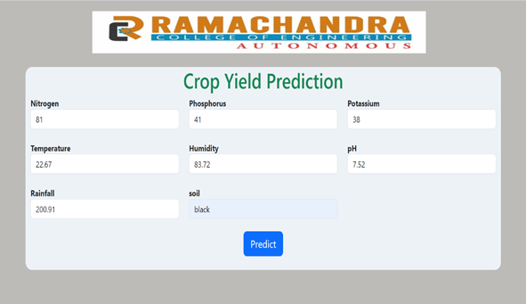
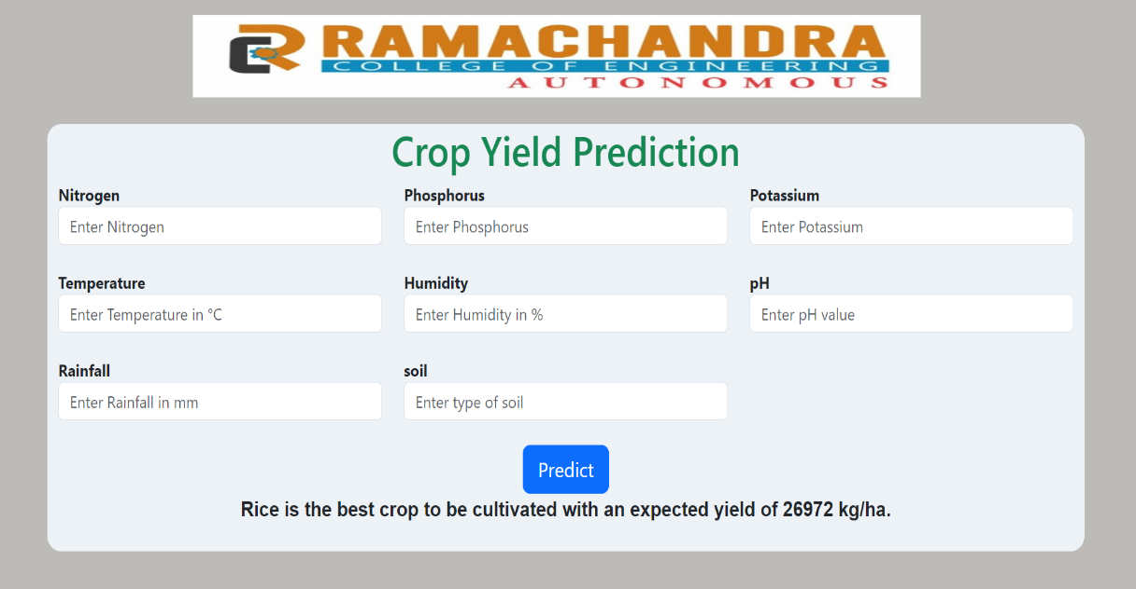
Screenshots:
Giving inputs for the prediction 2. Output for the given inputs

Slide 28
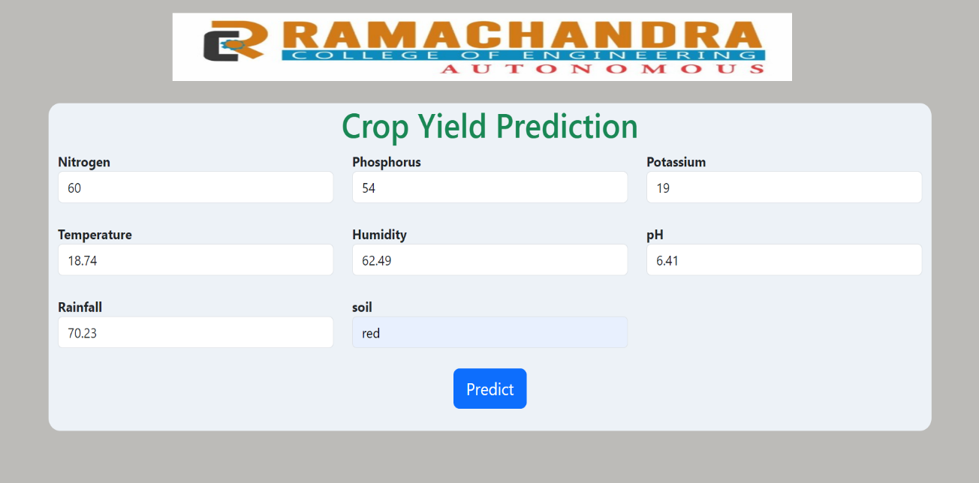
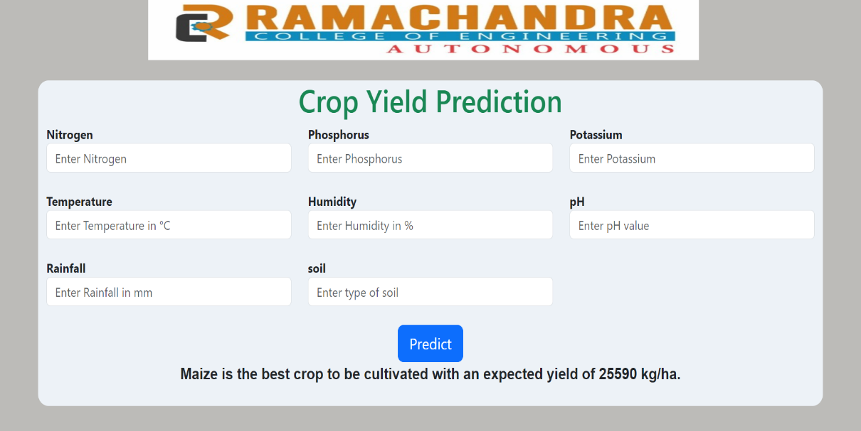
Screenshots
Giving inputs for the prediction 2. Output for the given inputs

Slide 29
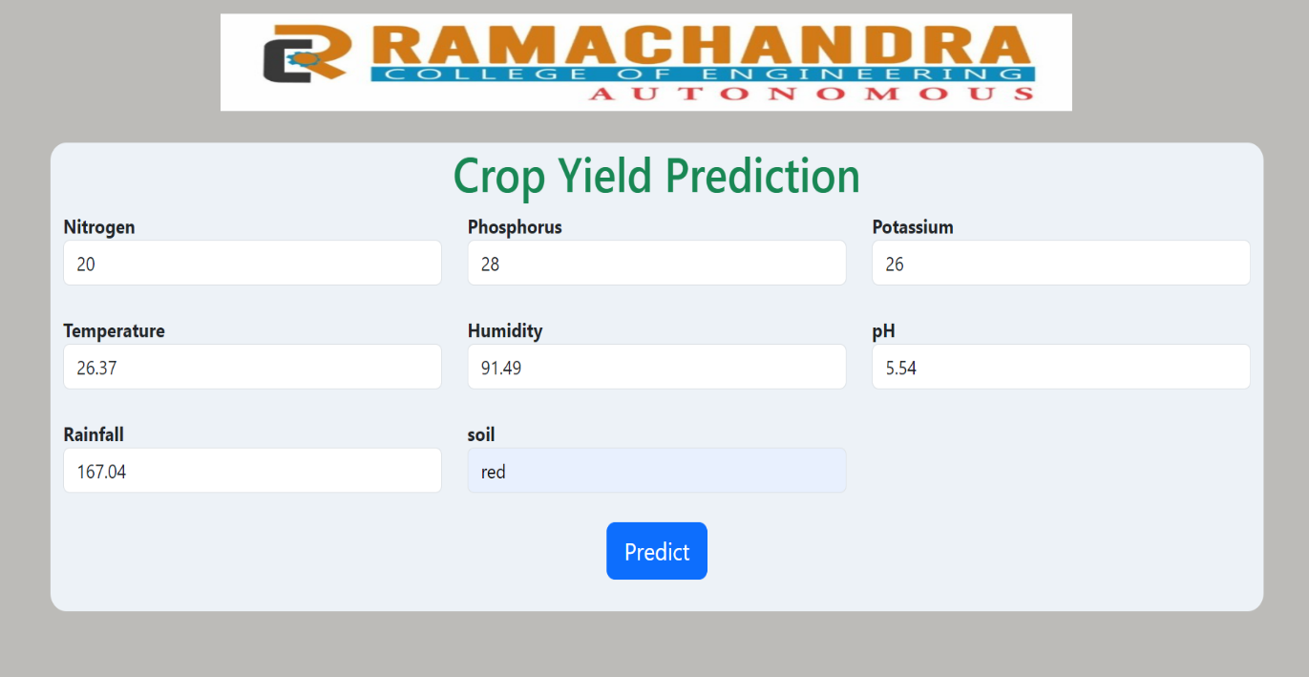
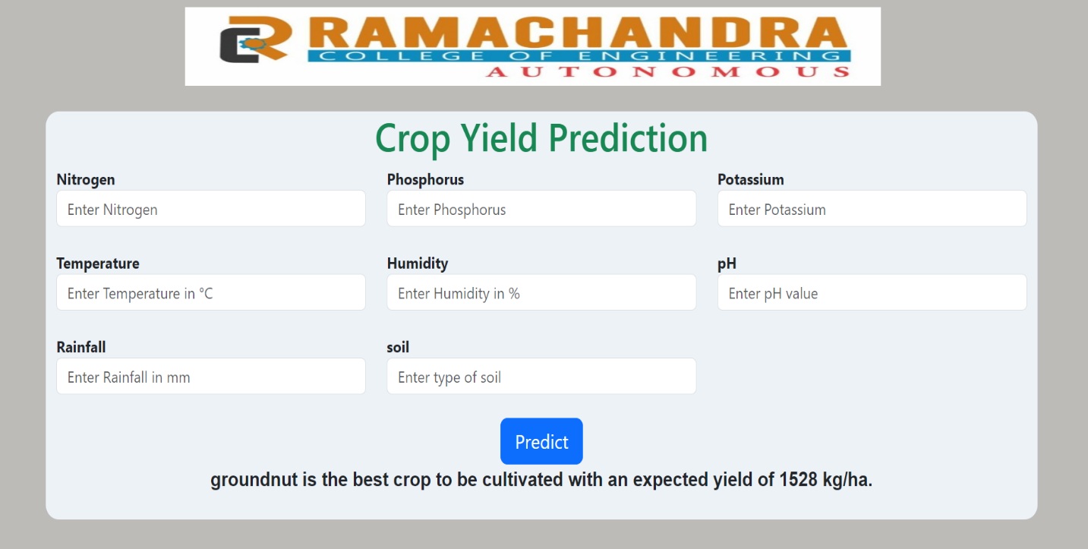
Screenshots
Giving inputs for the prediction 2. Output for the given inputs

Slide 30
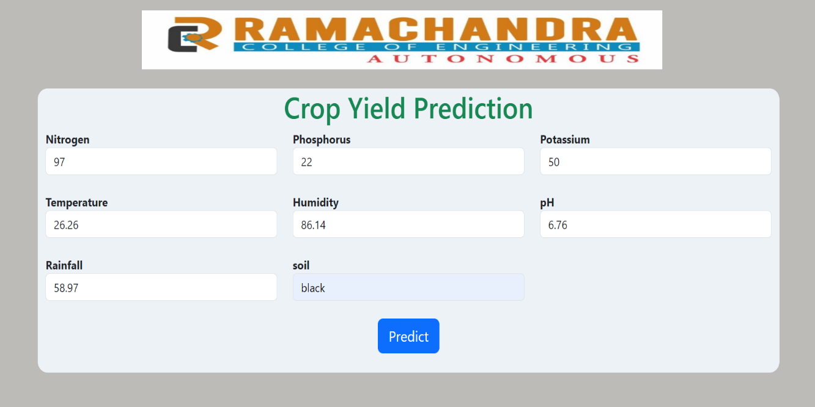
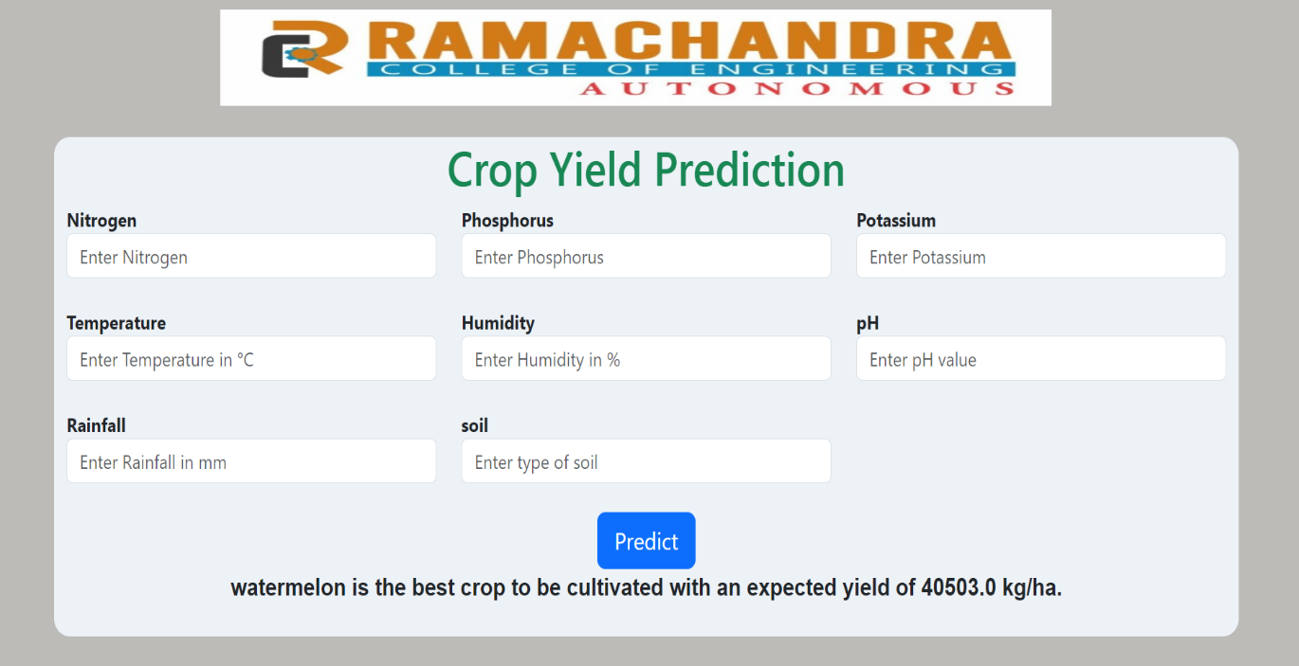
Screenshots
Giving inputs for the prediction 2. Output for the given inputs

Slide 31
Project Video
https://drive.google.com/file/d/1G2mvhPRv6Nti98tGA0PhFpQHl4JwpnVj/view?usp=sharingProject Video

Slide 32
Project Category
Paper Publication

Slide 33


